Slide 1
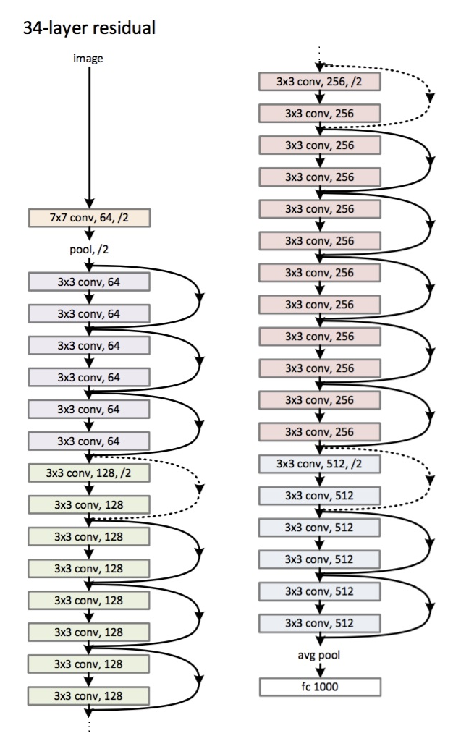

Safety Vest Detection Using Transfer Learning
Deep learning for workplace PPE compliance
Dataset: Kaggle Safety Vest Detection
Models: ResNet34
Notes:
Hello everyone, my name is Cong Ho. Today I will present about my classification project. In this project, I focused on a real-world computer vision task: detecting whether a person is wearing a safety vest, which is an important requirement in construction and industrial environments. Automating this check helps improve workplace safety and reduces the burden on manual monitoring. I used a public dataset from Kaggle and applied transfer learning to build the model. So let’s start with why we’re even doing this. Before jumping into models and data, here’s the actual real-world problem this project is trying to solve.

Slide 2
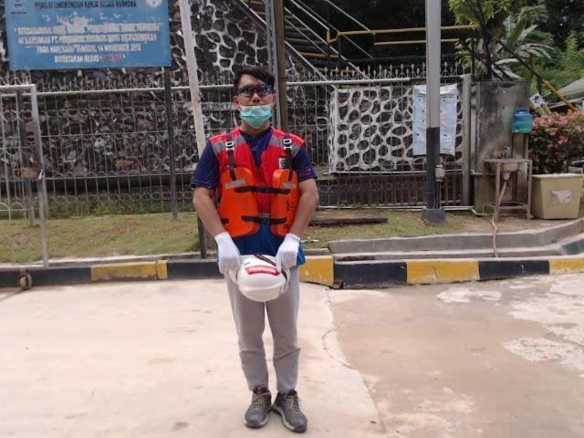
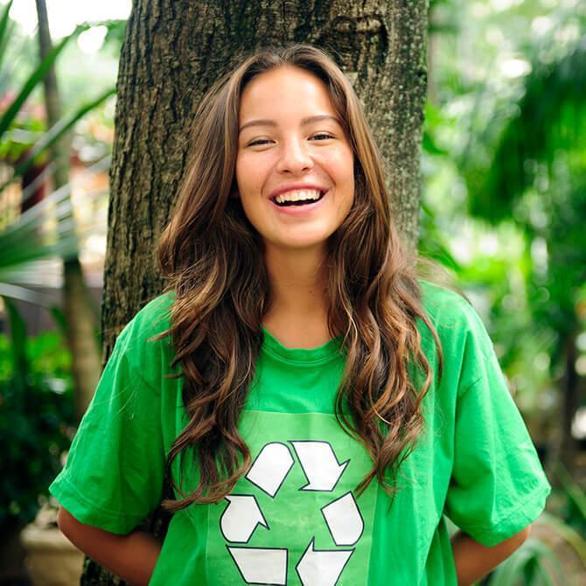
Problem Overview
Industrial environments require strict PPE rules
Safety vest usage protects workers
Manual monitoring = time-consuming, inconsistent
Goal: automate vest detection from images
← Safety Vest
VS
Not Safety Vest →
Notes:
In many industrial and construction environments, workers are required to wear safety equipment such as reflective vests to reduce the risk of accidents. Monitoring this manually can be time-consuming and inconsistent, especially in large worksites. The goal of this project is to build an automated system that can detect whether a person in an image is wearing a safety vest. By using computer vision and deep learning, specifically transfer learning, we can train a model to recognize this safety gear and support more efficient and reliable workplace compliance checks. Essentially, instead of relying solely on humans to visually inspect workers, we can leverage AI to help ensure safety rules are being followed. To solve that safety-monitoring problem, we obviously need data, real images where we can tell who’s wearing a vest and who’s not. That brings us to our dataset section.

Slide 3
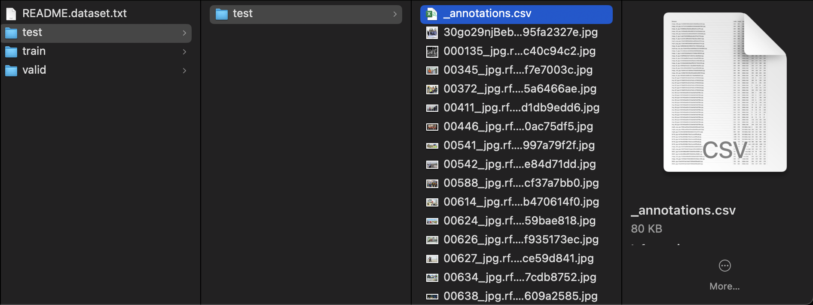
Dataset Source
Includes labeled images + bounding boxes
Categories: Safety Vest vs. No-Safety Vest
Link: https://www.kaggle.com/datasets/adilshamim8/safety-vests-detection-dataset
Notes:
The dataset contains labeled images from industrial settings. Each image includes bounding box coordinates identifying people. Using the annotation CSVs, I cropped each person’s region and labeled it as vest or not_vest. The data was separated into training, validation, and testing folders. The dataset link is included for reproducibility. Of course, this raw data never just works nicely right out of the box — that would be too easy. So the next step is preparing and structuring the data so the model can actually learn from it.

Slide 4
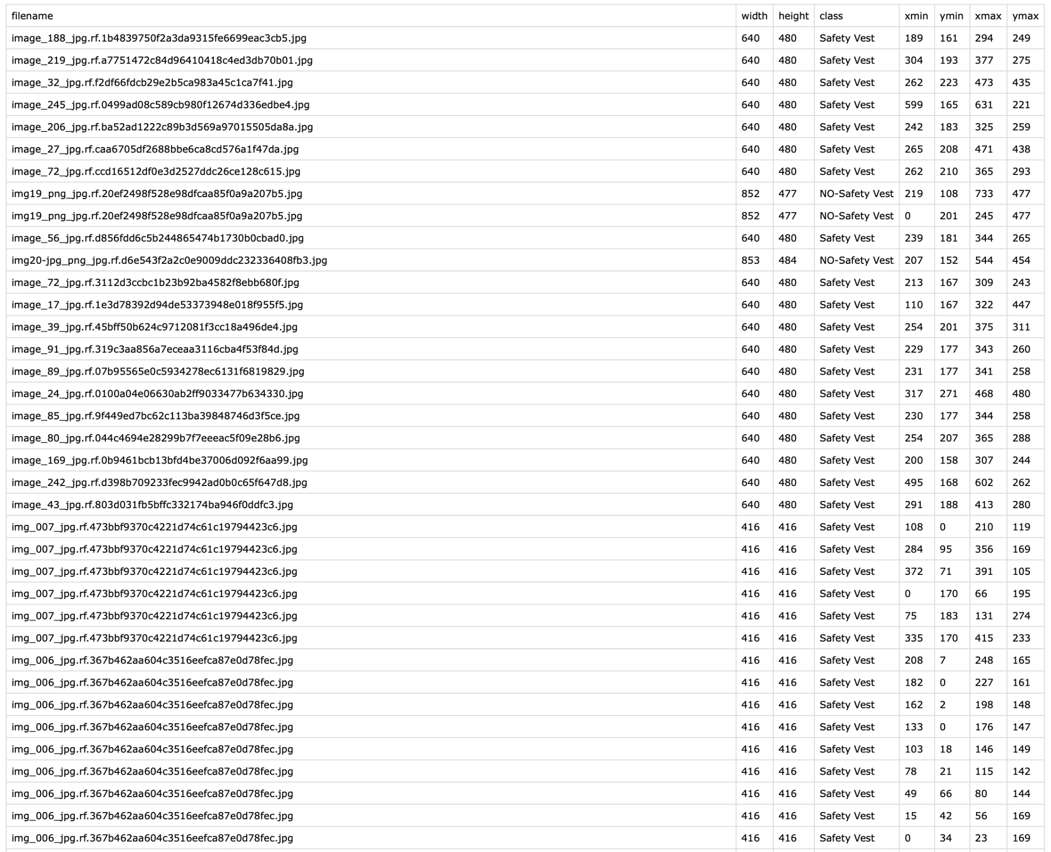
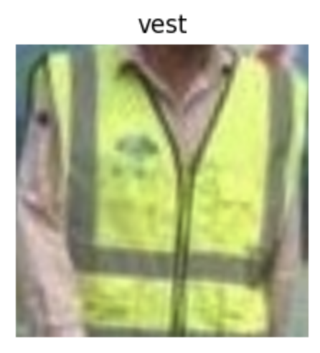
Data Preparation
Loaded annotation CSV files
Cropped bounding-box regions of workers
Mapped labels → vest / not_vest
Organized into train, valid, test
← Image after cropped
Notes:
To prepare the data for training, I started with the Kaggle Safety Vest dataset, which includes images and corresponding annotation files that specify bounding boxes around people and whether they are wearing a vest. First, I read the annotation CSVs and mapped the original labels into two categories: vest and not_vest. Then I cropped each image based on the bounding box coordinates so the model focuses only on the person rather than the background or environment. After cropping, I organized the images into separate folders for training, validation, and testing. This preprocessing step helps improve model accuracy by giving it clean, focused examples and ensures a proper evaluation pipeline for measuring performance on unseen data. Once the data was cleaned and organized, it was time to pick the right approach. Instead of training from scratch — because we like our GPUs alive — I decided to use the transfer learning.

Slide 5
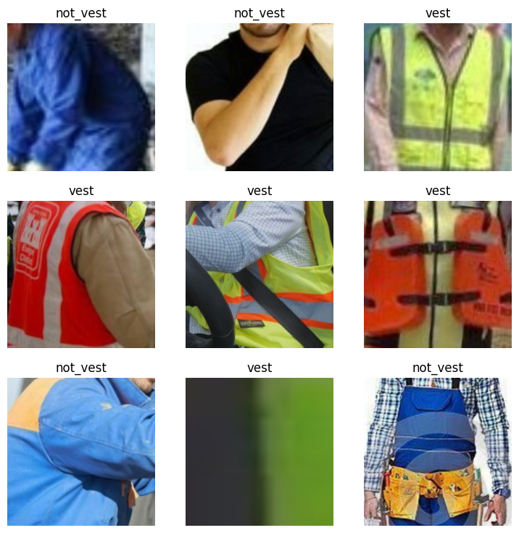
Model and Method
Framework: FastAI
Technique: Transfer Learning
Base model: ResNet34 pretrained on ImageNet
Transformations: resize, normalized, augmentations
Metric: error_rate
Notes:
For this project, I used transfer learning with the FastAI library, which allows us to take advantage of a neural network that has already been trained on a large dataset like ImageNet. Instead of training from scratch, I started with a pretrained ResNet34 model. This model already understands general visual patterns such as edges, shapes, and textures, so the main task here was fine-tuning it to recognize whether a person is wearing a safety vest. I created a DataLoader to feed the model preprocessed images, applied standard data augmentations to help the model handle variations in lighting and perspective, and used normalization to match the pretrained model’s input expectations. Then I used FastAI’s fine_tune function, which first trains the final layers and then gradually unfreezes earlier layers to adapt them to this specific task. This approach lets the model learn efficiently with less data and training time, while still achieving strong performance. Now let's go to the fun part — seeing whether this whole setup actually worked.

Slide 6
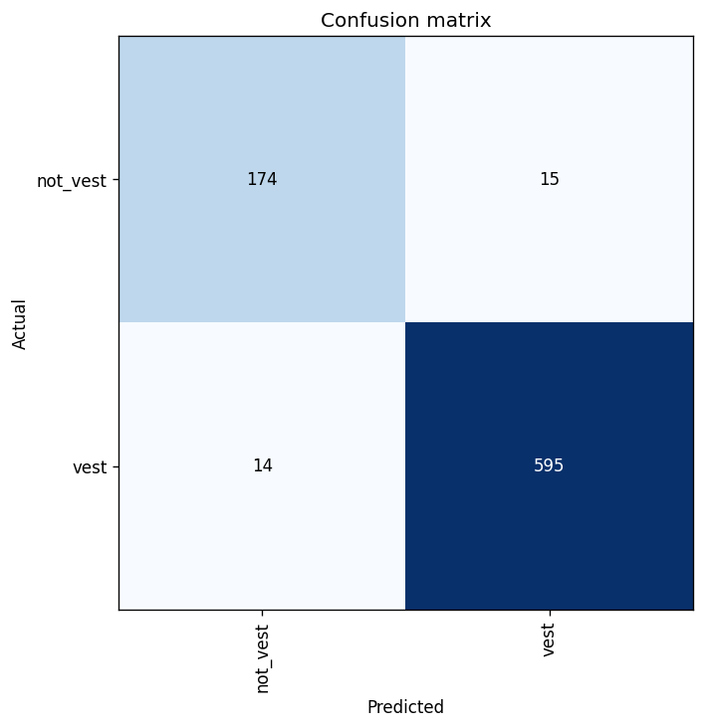
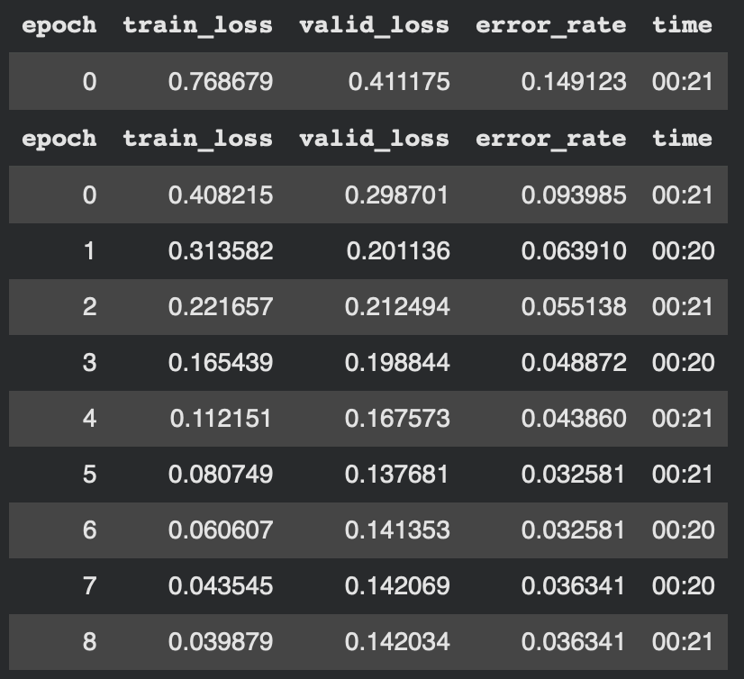
Results
Validation error ~3–6%
Vest accuracy ~98%
Non-vest accuracy ~87%
Confusion matrix shows strong performance
Some mislabels & ambiguity cases
Notes:
After training the model, we evaluated its performance on the validation set and the numbers turned out strong. The model reached a low validation error rate, and when we broke that performance down by class, it correctly identified the majority of “vest” cases with very high accuracy and performed well on “not vest” cases too, though with slightly lower accuracy due to class imbalance and more visual variation in those images. The confusion matrix shows that most predictions landed in the correct category, and the misclassifications typically came from challenging cases where the vest was partially blocked, poorly lit, or visually similar to non-vest clothing. Overall, these results suggest that the transfer learning approach worked effectively for this problem, and the model learned clear visual distinctions between the two categories. Those results look great on curated data, but life outside Kaggle isn’t always that kind. So I tested the model on images it’s never seen before to check how well it generalizes.

Slide 7
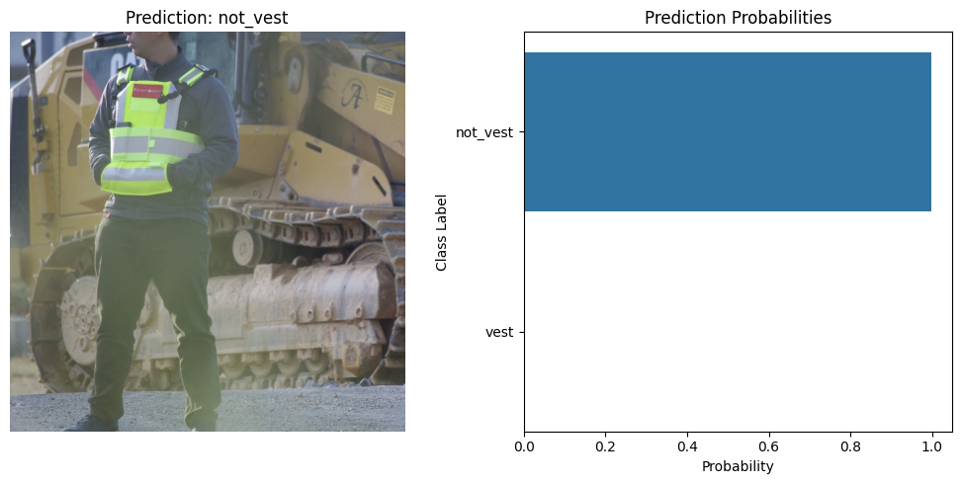
Generalization Test
Tested on external real-world image
Model struggled under different lighting/background
Shows dataset diversity matters
Notes:
To make sure the model wasn’t just memorizing the training data, I tested it on an image that did not come from the Kaggle dataset. This simulates a real-world scenario where the model might see different lighting conditions, backgrounds, and camera angles. In my test, the model attempted to classify whether a worker was wearing a vest, but it struggled with the external image because the scene looked different from the dataset. This result shows that while the model performs very well on the curated dataset, its performance drops when the environment changes. It highlights the importance of diverse and realistic training data, especially if the goal is to deploy a system like this in live workplace settings. In the future, adding more real-world examples and expanding the dataset would help improve generalization and robustness. Based on all this testing — both clean data and real-world images — here’s what we can take away from the project so far.

Slide 8
Conclusion
Transfer learning effective
High validation performance
Real-world edge cases reduce accuracy
Next: expand dataset, test ResNet50, augment heavy, handle imbalance
Model | Accuracy | Note
ResNet34 | ~94-97% | Fast, Efficient
ResNet50 | Coming next | Expect higher accuracy
Notes:
In summary, this project demonstrated that transfer learning is an effective and efficient way to build a safety-vest detection model, even with a small dataset. By fine-tuning a pretrained ResNet model, we achieved strong performance on the validation set and showed that the model can distinguish between workers wearing vests and those who are not. At the same time, testing on images outside the dataset highlighted the challenge of real-world variability — especially with lighting, background clutter, and different camera conditions. This suggests that while the model performs well in controlled scenarios, expanding the dataset and incorporating more diverse images would make it more robust and deployment-ready. Overall, this project reinforces the value of transfer learning for practical image classification problems and sets a clear path for future improvement, including trying deeper architectures like ResNet50 and strengthening the data pipeline.

Slide 9
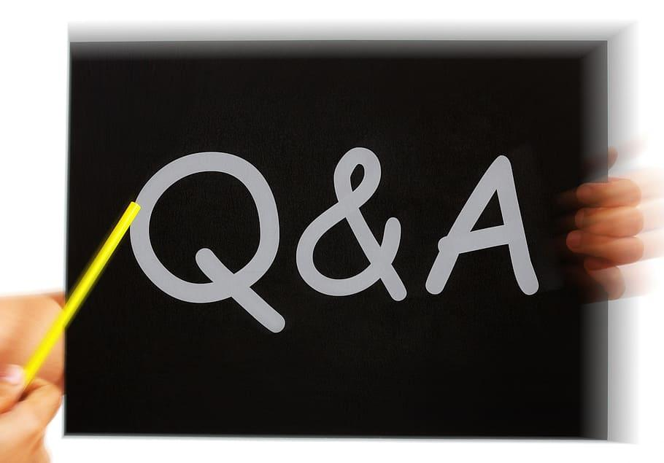
Notes:
And that wraps up the project, feel free to hit me with questions or feedback and I’d be happy to answer any questions you have about this project.

